Slide 1

Welcome to the Robin Class

Slide 2

Introductions…
Mrs Bani (Class teacher)
Miss Ellis (Teaching Assistant)
Mrs Pryal (Teaching Assistant)
Mr Cartwright (Teaching Assistant)

Slide 3

Robin is a Key Stage 4 class made up of pupils from both years 10 and 11.

Slide 4

Equipment
All equipment is provided by school.
This includes stationery and aprons for food technology lessons.

Slide 5



What should pupils bring to school daily?
Pupils have all been given a planner this is to used for school/home communication. Please feel free to write any notes to class staff in here. Staff will also use planners to pass on any messages home, please check these daily.
Reading books and records are given in line with pupils' phonics assessments. We aim to read with your child on a 1:1 basis at least once a week. Please record in the reading record when your child has read at home.
Books will be changed as required.
Water bottles can be provided in class but pupils can bring one from home if they prefer.

Slide 6
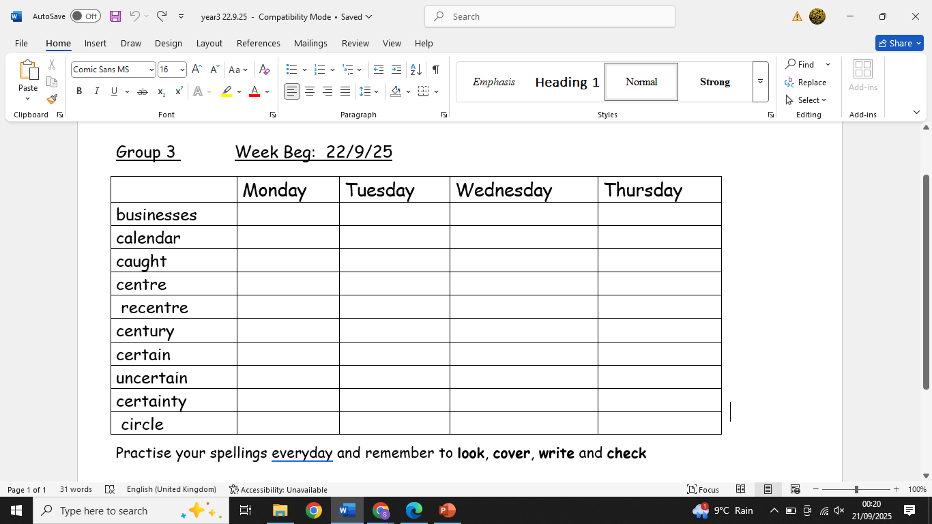
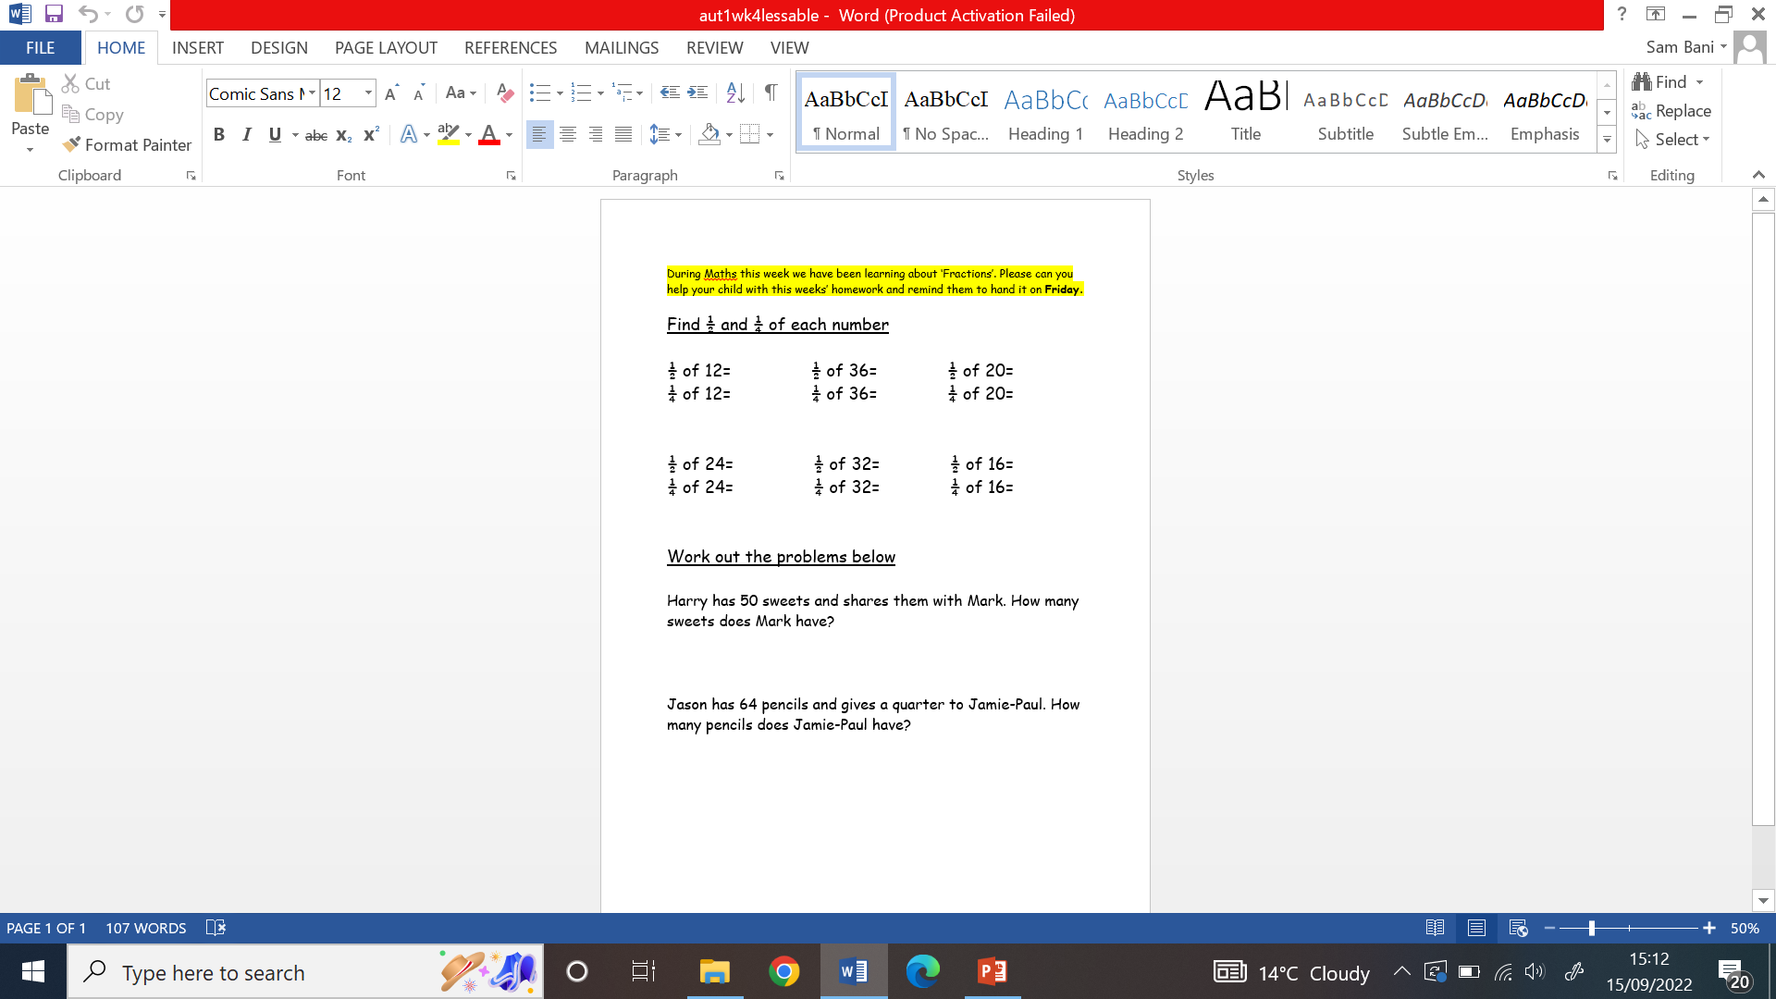
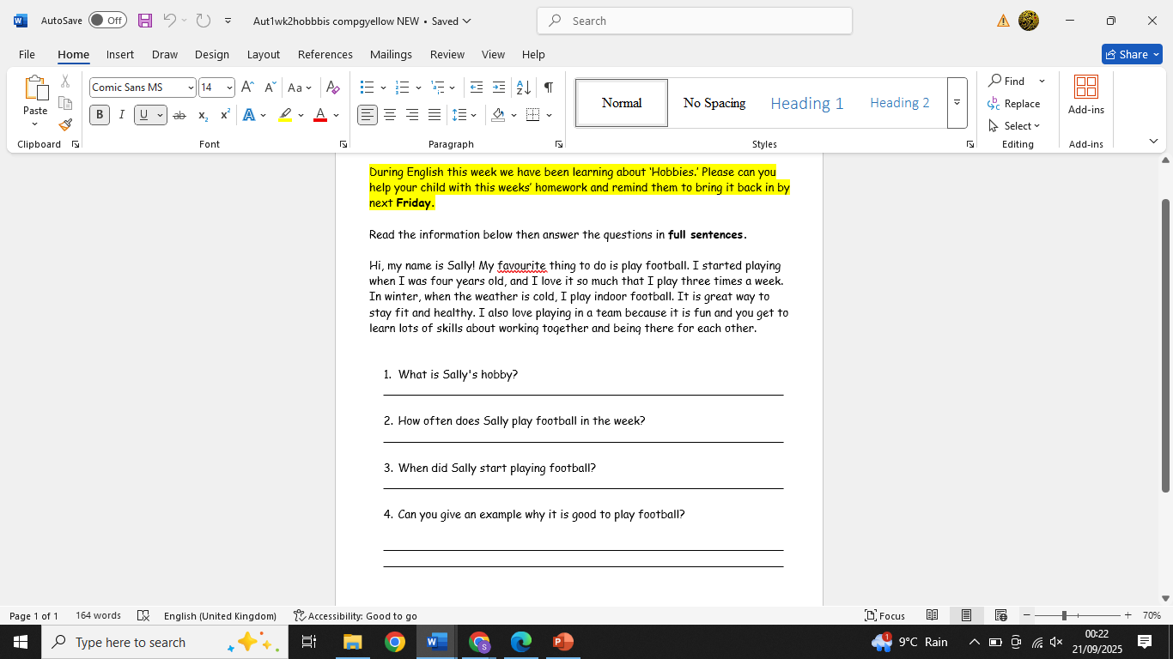
Spellings and homework
Weekly spellings will be sent home on a Monday. There is a weekly spelling test each Friday.
Pupils will have the opportunity to practise these in class each morning during the phonic lesson but should also practise at home using look, cover, write and check.
English and Maths homework is sent home every Friday. Pupils should return this the following Friday.

Slide 7

PE
P.E is on a Thursday and pupils are expected to wear the correct P.E uniform:
Dark joggers/leggings/shorts-black or grey
White T-shirt
Trainers

Slide 8
Robin Curriculum
The Robin curriculum includes all statutory subjects’. This includes English, Maths, Science, Computing, Employability, Physical Education and Personal and Social Development. In each subject pupils are working towards Personal progress at Entry Level 1.

Slide 9
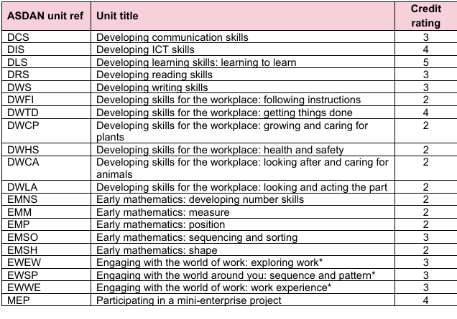
Robin Curriculum breakdown
Pupils are expected to complete units from different subjects including Maths and English.
Each unit is given a credit rating At end of two years in KS4 credits are submitted for their Entry Level 1 accreditation.

Slide 10
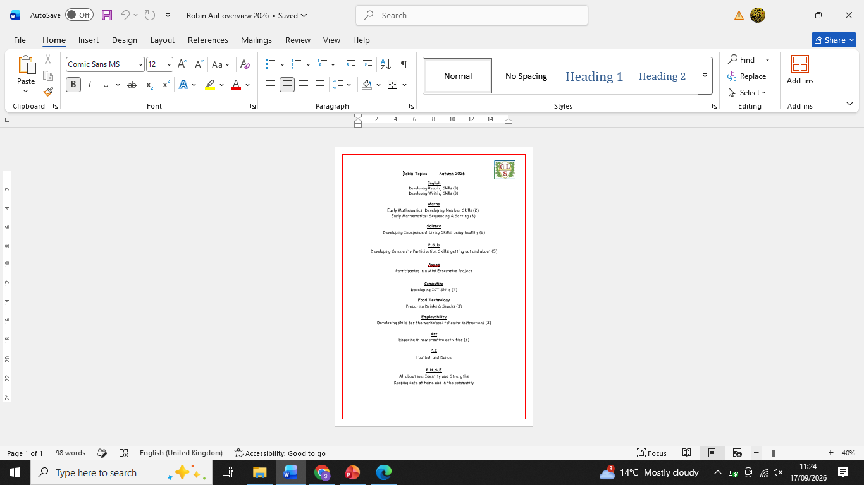
Termly overviews
This is the Autum termly overview showing what topics are being taught and the credits for each subject.

Slide 11

Entry Levels
Entry level
Each entry level qualification is available at three sub-levels - 1, 2 and 3.
Entry level 3 is the most difficult.

Slide 12
Entry Level
Entry level
Entry level qualifications are:
entry level award
entry level certificate (ELC)
entry level functional skills

Slide 13
Entry Level
Entry level
Entry level qualifications are:
entry level award
entry level certificate (ELC)
entry level functional skills

Slide 14
What does it mean?
GCSE - grades 3, 2, 1 or grades D, E, F, G
level 1 functional skills
level 1 national vocational qualification (NVQ)

Slide 15
What does it mean?
Level 2
Level 2 qualifications are:
GCSE - grades 9, 8, 7, 6, 5, 4 or grades A*, A, B, C
intermediate apprenticeship
level 2 functional skills

Slide 16
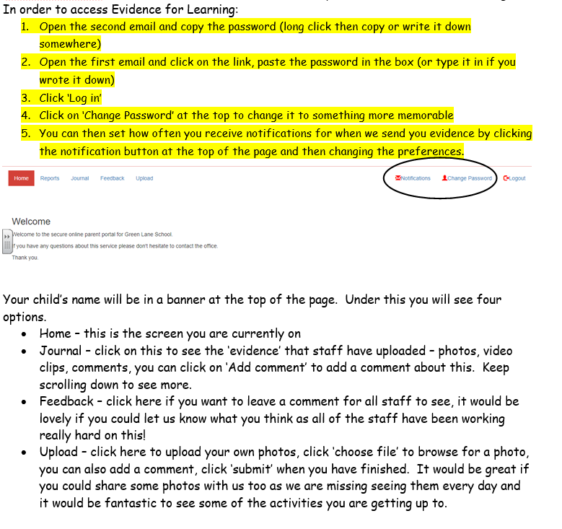
EFL-Evidence for learning
At Green Lane School we use an application called ‘Evidence for Learning (EfL)’ to record your child’s learning. We take snapshots of your child’s learning throughout their time at Green Lane School and then upload them to create a learning journey.
When you are signed up to EfL, you will receive two automated emails from ‘TheTeacherCloud’ one containing a link to your child’s Parent View Portal and the other with your password. You can change the password to one of your own choice when you first login.

Slide 17

Any questions?

Slide 18

Thank you for taking the time to join us this afternoon! As always your support is much appreciated.

