Slide 1

Welcome to Woodpecker CLASS!

Slide 2
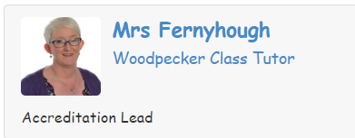
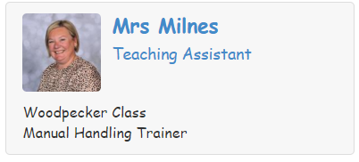
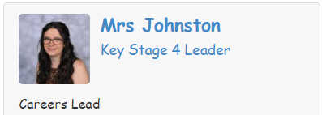
Meet the Staff.

Slide 3
The School Day
8.50 a.m. – Start of school Day
10.40 – 10.55 – Break
12 p.m. – Lunch break
12.30 – Lunch
1.00 p.m. – Afternoon lessons
3.15 p.m. – Finish lessons ready for home time.

Slide 4
Woodpecker Curriculum
Maths AQA ELC @ Entry Level 2/3
English AQA ELC @ Entry Level 2/3
Computing Ingots FS@ELC @ Entry Level 2/3
Art OCR ELC @Entry Level 2/3
PE OCR ELC @Entry Level 2/3
Asdan PSD ELC @ Entry Level 2/3
Asdan Employability ELC @ Entry Level 2/3
Asdan PDP Asdan Gold Award
Science Short Course 6 credit pass
Asdan Food Wise Short Course 6 credit pass
Asdan SRE/PSE Short Course 6 Credit pass
The Woodpecker curriculum includes all statutory subjects at Key Stage 4. This includes English, Maths, Science, Computing, Physical Education and Citizenship (Personal and Social Development - PSD/Sex and Relationships Education - SRE.)
In addition to this pupils complete several ASDAN areas and study.
ASDAN includes Personal Development Programmes and short courses which aim to develop personal, independent living and employability skills for young people with additional needs.

Slide 5


Slide 7
Lunch time arrangements
School lunch – There are usually 1 or 2 hot menu options each day. There is also a jacket potato option or pupils can order a packed lunch.
Home packed lunch – There is a packed lunch club for Key Stage 4 in Hawk classroom.

Slide 8

Equipment
All equipment is provided by school. Pupils each have their own pencil case which contains everything that they could possibly need in class.
MOBILE PHONES
Pupils are allowed to bring their phone to school as some pupils like to use these on transport. Phones must be locked in the class cupboard and switched off during the day.

Slide 9


What should pupils bring to school daily?
.
Reading books and records are given in line with pupils phonics assessments and reading/spelling ages. We aim to read with your child on a 1:1 basis 2x each week. Please record in the reading record when you have read with your child at home.
Books will be changed as required.
Water bottles can be sent in from home.

Slide 10
Key Information
Spellings will be sent home every week and there will be a test on a Friday.
Homework will be sent home each Friday and should be returned on the following Friday.
We are completing assessments so reading books etc. may change.
P.E. kit needs to be worn on a Wednesday and this should be a white top and dark coloured shorts or joggers and trainers.
No football club tops or bright hoodies please.

Slide 11

Any questions? Please contact Mrs F or Mrs Milnes.

Slide 12

Thank you for taking the time to join us and welcome to the Woodpecker family!

