Slide 1
Maths
Measurement
Year One
Maths | Year 4 | Measurement | Converting Units of Measurement | Lesson 4 of 5: Converting Units of Volume and Capacity

Slide 3
Aim
I can convert between units of volume and capacity.
Success Criteria
I can convert from litres to millilitres by multiplying by 1000.
I can convert from millilitres to litres by dividing by 1000.
I can use the inverse operation to convert from millilitres to mixed units and vice versa.

Slide 4
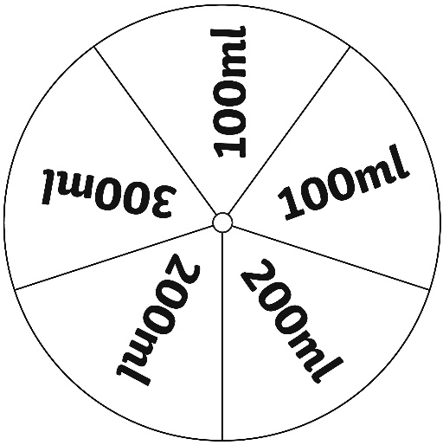
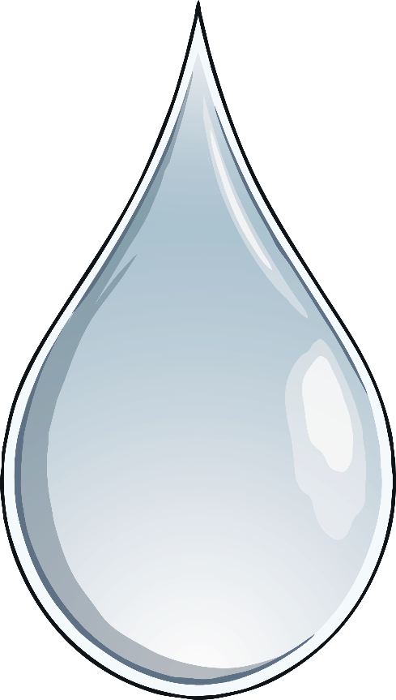
Spin It!
Take it in turns to spin the Hundred Millilitres Spinner.
Keep a running total of the numbers you roll. The aim of the game is to reach exactly 1000ml. If you go over 1000ml, you have to start from zero. Every time you reach exactly 1000ml, you score 1000. Keep a track of your score. When your teacher says ‘Stop’, the person with the highest number of points is the winner.

Slide 5
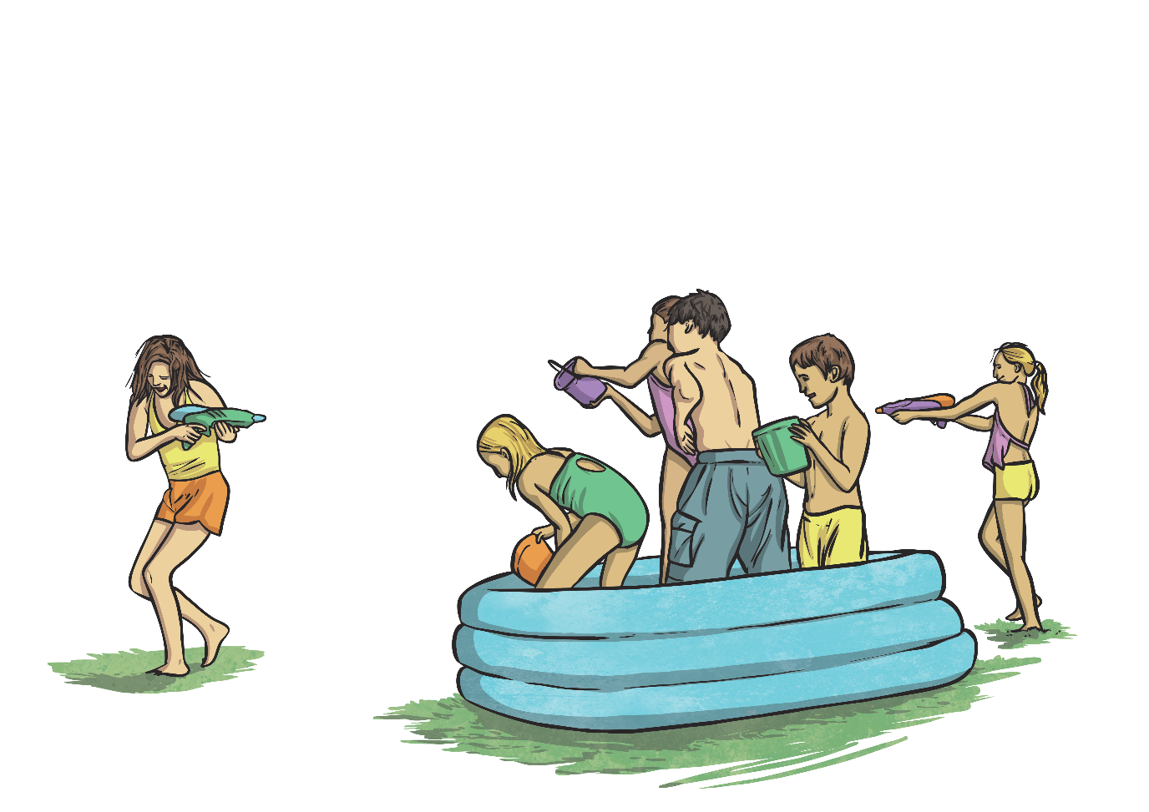
Converting Litres
to Millilitres
A litre is equivalent to 1000ml.
1 litre | 2 litres | 3 litres | 4 litres | 5 litres | 6 litres | 7 litres | 8 litres | 9 litres | 10 litres
1000ml
2000ml
3000ml
4000ml
5000ml
6000ml
7000ml
8000ml
9000ml
10 000ml

Slide 6
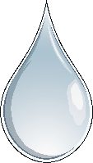
Converting Litres
to Millilitres
How many millilitres in…?
2 litres
7 litres
9 litres
3 litres
2000ml
7000ml
9000ml
3000ml
8 litres
4 litres
6 litres
5 litres
8000ml
4000ml
6000ml
5000ml
?
?
What calculation do we need to do to convert from litres to millilitres?
What do you notice about the answers?
Millilitres are smaller than litres, so there are more of them in the same volume. There are a thousand times as many millilitres in the same volume as litres.
We need to multiply the number of litres by 1000.

Slide 7
Converting Litres
to Millilitres
Sometimes, measurements are written in mixed units, e.g. 5l 500ml. What would we need to do to answer the following questions?
We need to convert the litres to millilitres by multiplying by 1000. We then need to add the extra millilitres on to find the total.
?
How many millilitres in 1l 500ml?
1l = 1000ml
1000ml + 500ml = 1500ml
?
How many millilitres in 2l 250ml?
2l = 2000ml
2000ml + 250ml = 2250ml
?
How many millilitres in 4l 750ml?
4l = 4000ml
4000ml + 750ml = 4750ml

Slide 8
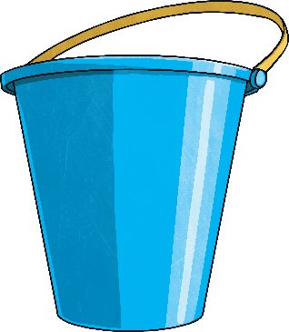
Converting Litres
to Millilitres
How many millilitres in…?
6l 750ml
5l 250ml
3l 500ml
3500ml
6750ml
5250ml

Slide 9
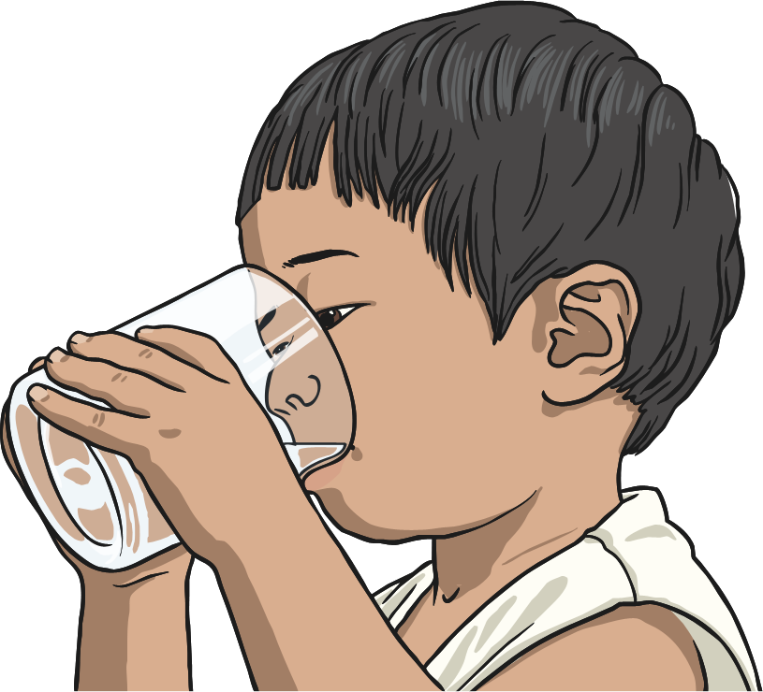
Converting Millilitres
to Litres
To convert from litres to millilitres, we multiply by 1000. What do you think we need to do to convert from millilitres to litres?
We need to divide the number of millilitres by 1000.
8000ml ÷ 1000 = 8l
If this creates a decimal number, the thousandths can be written as millilitres:
6500ml ÷ 1000 = 6.500 = 6l 500ml

Slide 10
Converting Millilitres
to Litres
How many litres in…?
2750ml
8500ml
4000ml
4l
2l 750ml
8l 500ml

Slide 11
Ordering Measurements
Here are 3 measurements:
5000ml
4l 250ml
3500ml
4250ml
First, change the measurements into the same unit.
Now, order the measurements.
3500ml
4l 250ml
5000ml
Key Fact
1 litre = 1000ml

Slide 12
Ordering Measurements
Order these measurements:
2250ml
1l 500ml
2l 750ml
2l 250ml
1l 500ml
2250ml
2l 750ml
Key Fact
1 litre = 1000ml

Slide 13
Ordering Measurements
Order these measurements:
4l 250ml
7750ml
5500ml
6l 250ml
4250ml
6250ml
4l 250ml
5500ml
6l 250ml
7750ml
Key Fact
1 litre = 1000ml

Slide 14
Ordering Measurements
Order these measurements:
2l 200ml
2500ml
2005ml
2l 250ml
2200ml
2250ml
2005ml
2l 200ml
2l 250ml
2500ml
Key Fact
1 litre = 1000ml

Slide 15
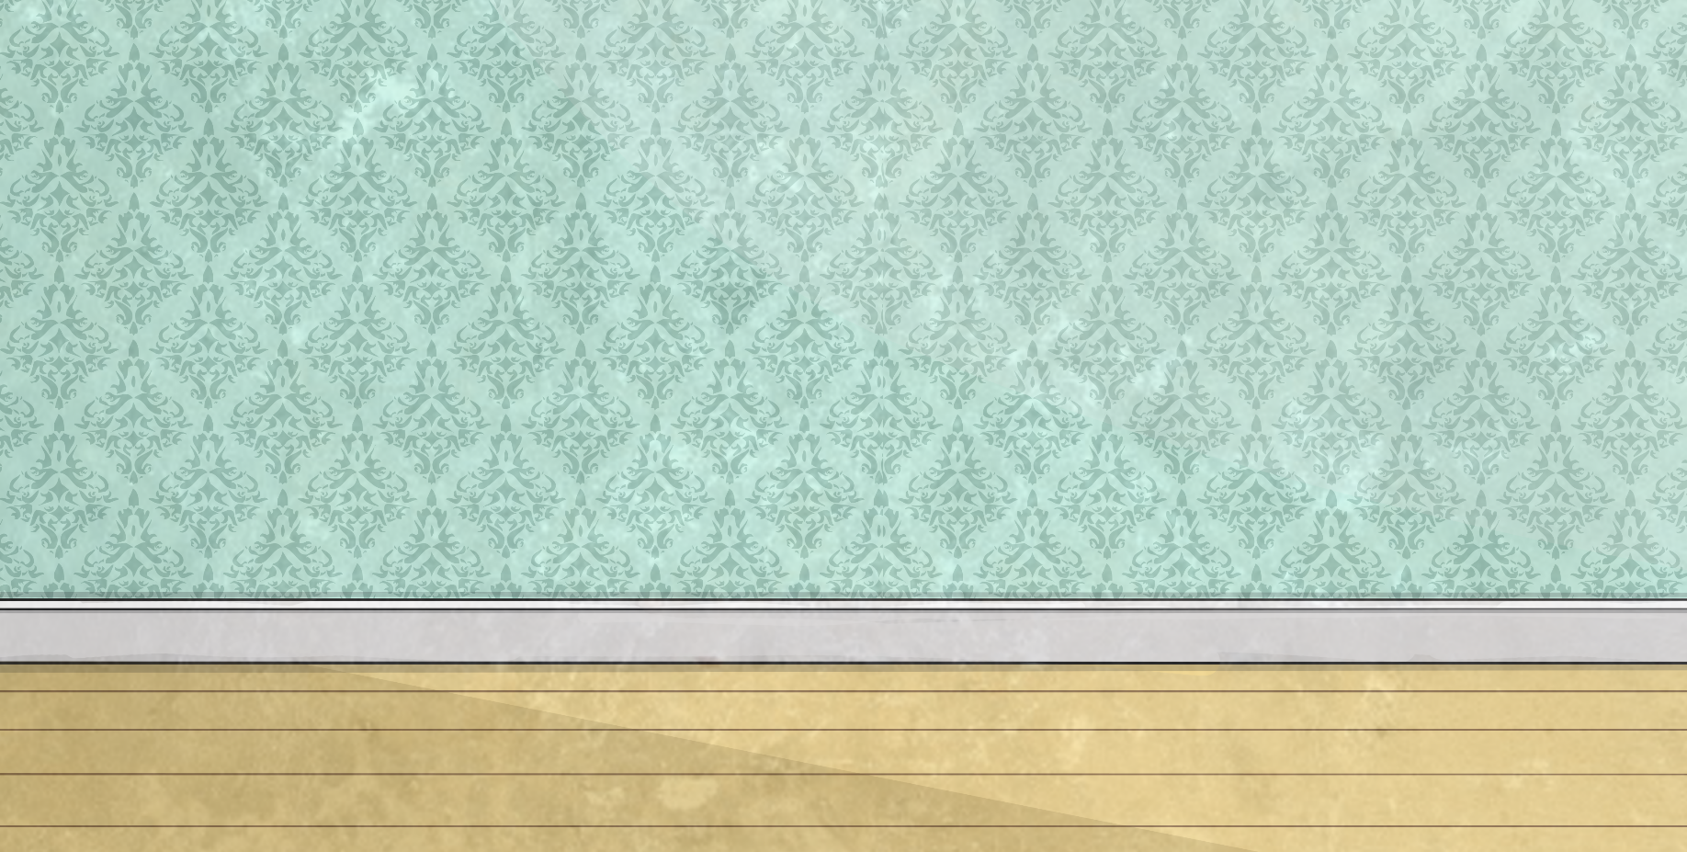
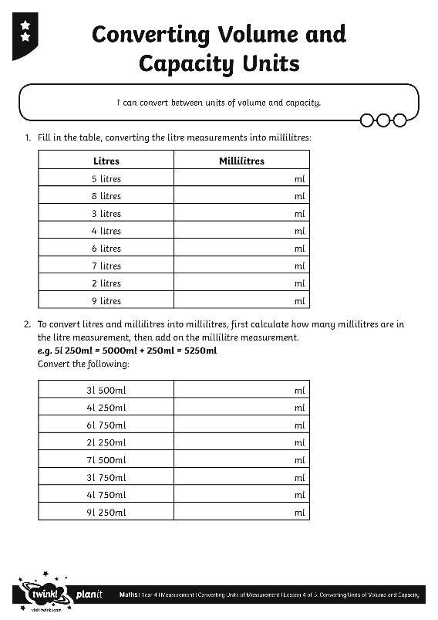
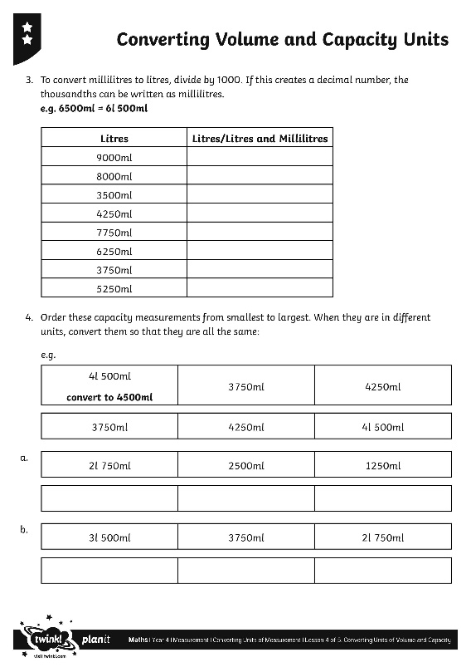
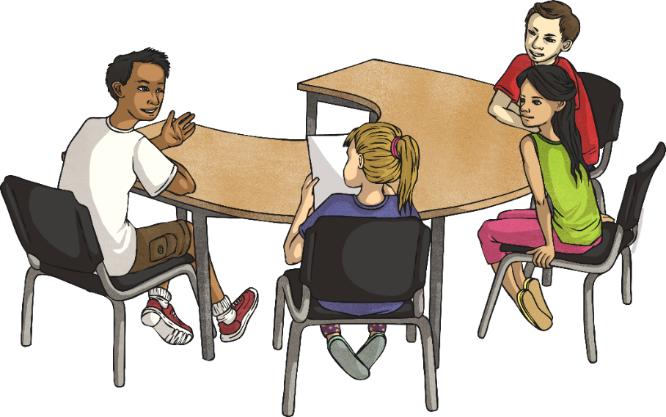
Converting Volume and
Capacity Units
Use your captivating conversion skills to complete this activity sheet.

Slide 16
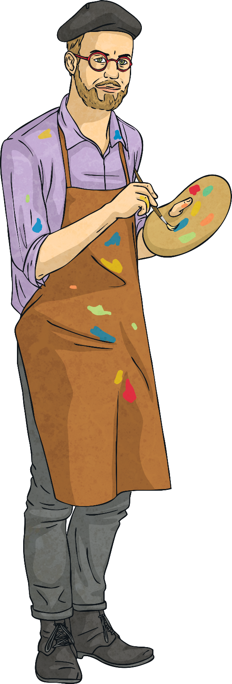
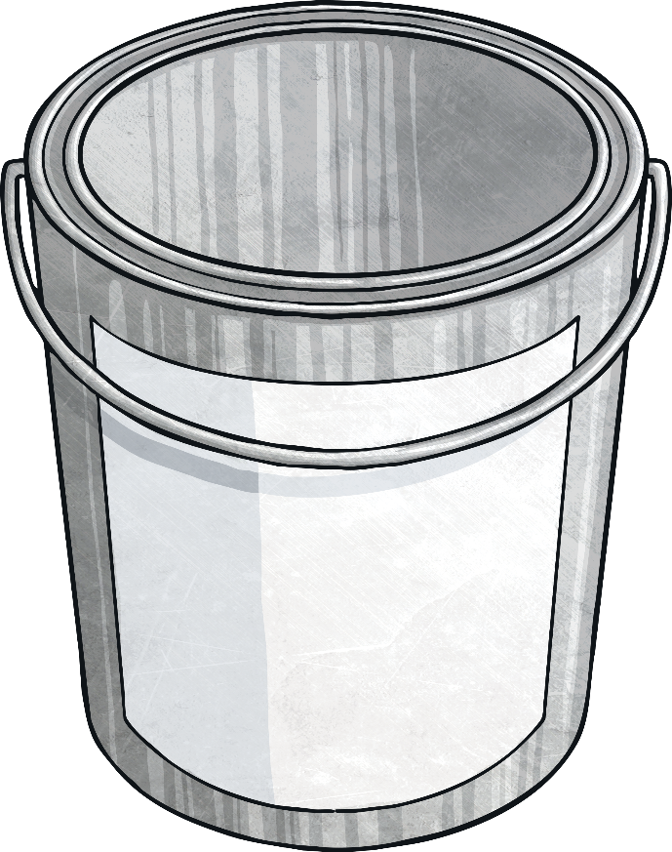
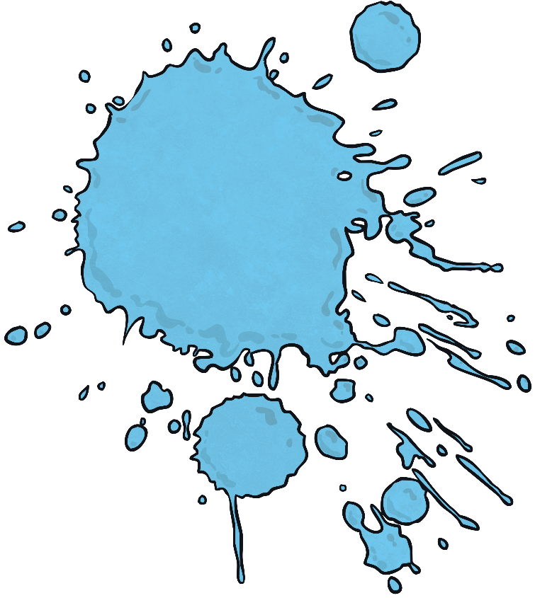
How Much More?
How much more do you need to add to the amount shown to make 5 litres? Write your answer in millilitres.
add
1500ml
5l
3500ml

Slide 17
How Much More?
How much more do you need to add to the amount shown to make 5 litres? Write your answer in millilitres.
add
2250ml
2l 750ml
5l

Slide 18
How Much More?
How much more do you need to add to the amount shown to make 5 litres? Write your answer in millilitres.
add
500ml
4500ml
5l

Slide 19
How Much More?
How much more do you need to add to the amount shown to make 5 litres? Write your answer in millilitres.
add
3800ml
1200ml
5l

Slide 20
How Much More?
How much more do you need to add to the amount shown to make 5 litres? Write your answer in millilitres.
add
735ml
4l 265ml
5l

Slide 21
How Much More?
How much more do you need to add to the amount shown to make 5 litres? Write your answer in millilitres.
add
2992ml
2008ml
5l

Slide 22
Aim
I can convert between units of volume and capacity.
Success Criteria
I can convert from litres to millilitres by multiplying by 1000.
I can convert from millilitres to litres by dividing by 1000.
I can use the inverse operation to convert from millilitres to mixed units and vice versa.

