Slide 1
Welcome to Otter class 2023-2024

Slide 2
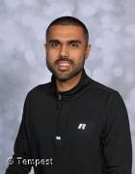
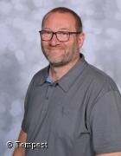
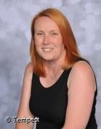
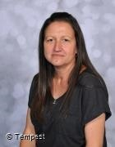
Introductions…
Mr Sidhu
Mrs Burton
Mr Cartright
Miss Gill

Slide 3
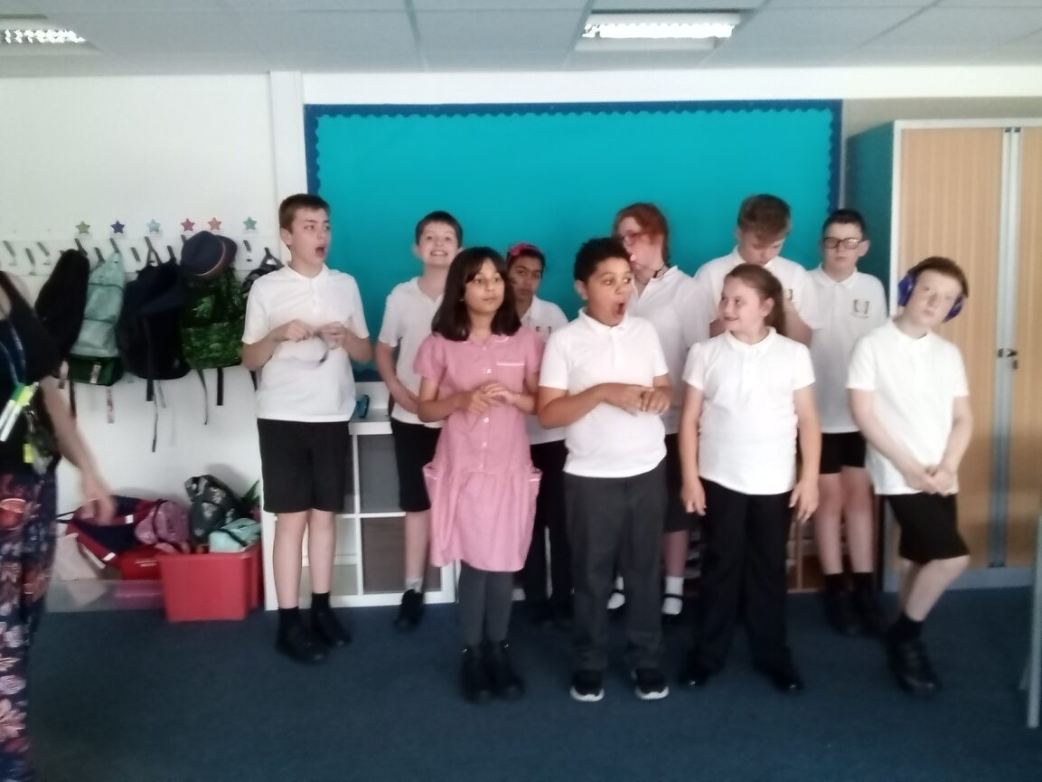
Otter class is made up of KS3 pupils from years 7-9

Slide 4
Equipment
All equipment is provided by school. Pupils each have their own pencil case which contains everything that they could possibly need in class.

Slide 5
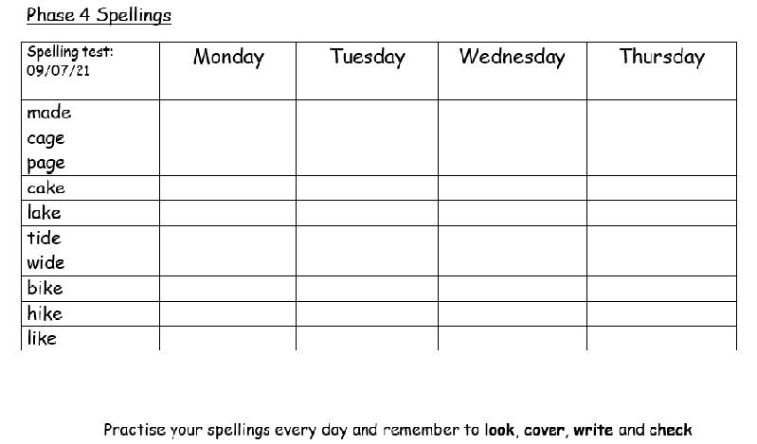
Spellings and homework
Homework will be given out on a Monday and we ask for it to be returned on the Friday at the end of the week.
New spellings will be given out each week and focused on your child's learning age. Please practise at home with your child and they will also practise in school every morning.
Homework will be alternate English and Maths each week.

Slide 6
What should pupils bring to school daily?
Pupils have all been given a planner. Every Monday they will add any important information for the week ahead.
These are also used for school/home communication. Please feel free to write any notes to class staff in here. Staff will also use planners to pass on any messages home, please check these daily.
Reading books and records are given in line with pupils phonics assessments. We aim to read with your child on a 1:1 basis 3x each week. Please record in the reading record when you have read with your child at home.
Books will be changed as required.
Water bottles and snack if required.

Slide 7
PE, Art, Technology, Spanish and RE
PE – Thursday
Otter class will be taught Spanish and RE by Mrs Stunnell.
Mrs Burton will teach Technology and Art.
Mr Sidhu will teach all other subjects.
Pupils should come to school in their PE kit on Thursdays.
PE is taught by the Warrington Wolves foundation coaches.

Slide 8
Otter Curriculum and Overview
The Otter class curriculum follows the national curriculum but is adapted to the needs of the children. The website will show what is being taught in each subject per term.

Slide 9
Evidence For Learning
To make sure you have access you can download the EFL family app from the playstore/app store.
Log in details are:
Domain: greenlane (no spaces or caps)
Username: your email address
Password: What you set first time.
If you need help to reset let me know!
The EFL app is used to share information on the work we have been completing in class with you.
We will aim to share some work per subject per week.

Slide 10
Any questions?

Slide 11
Thank you for taking the time to join us this afternoon! As always your support is much appreciated.

