Slide 1
Welcome to Deer Class
2023-2024

Slide 2
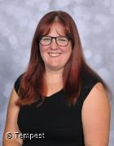
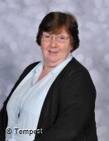
Introductions…
Miss Taylor
Class Teacher
Mrs T
Class TA

Slide 3
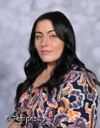
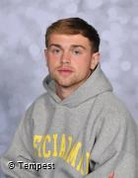
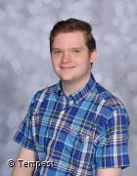
Introductions…
Miss B
1:1 TA
Mr Edwards
1:1 TA
Mr Brant
1:1 TA

Slide 4
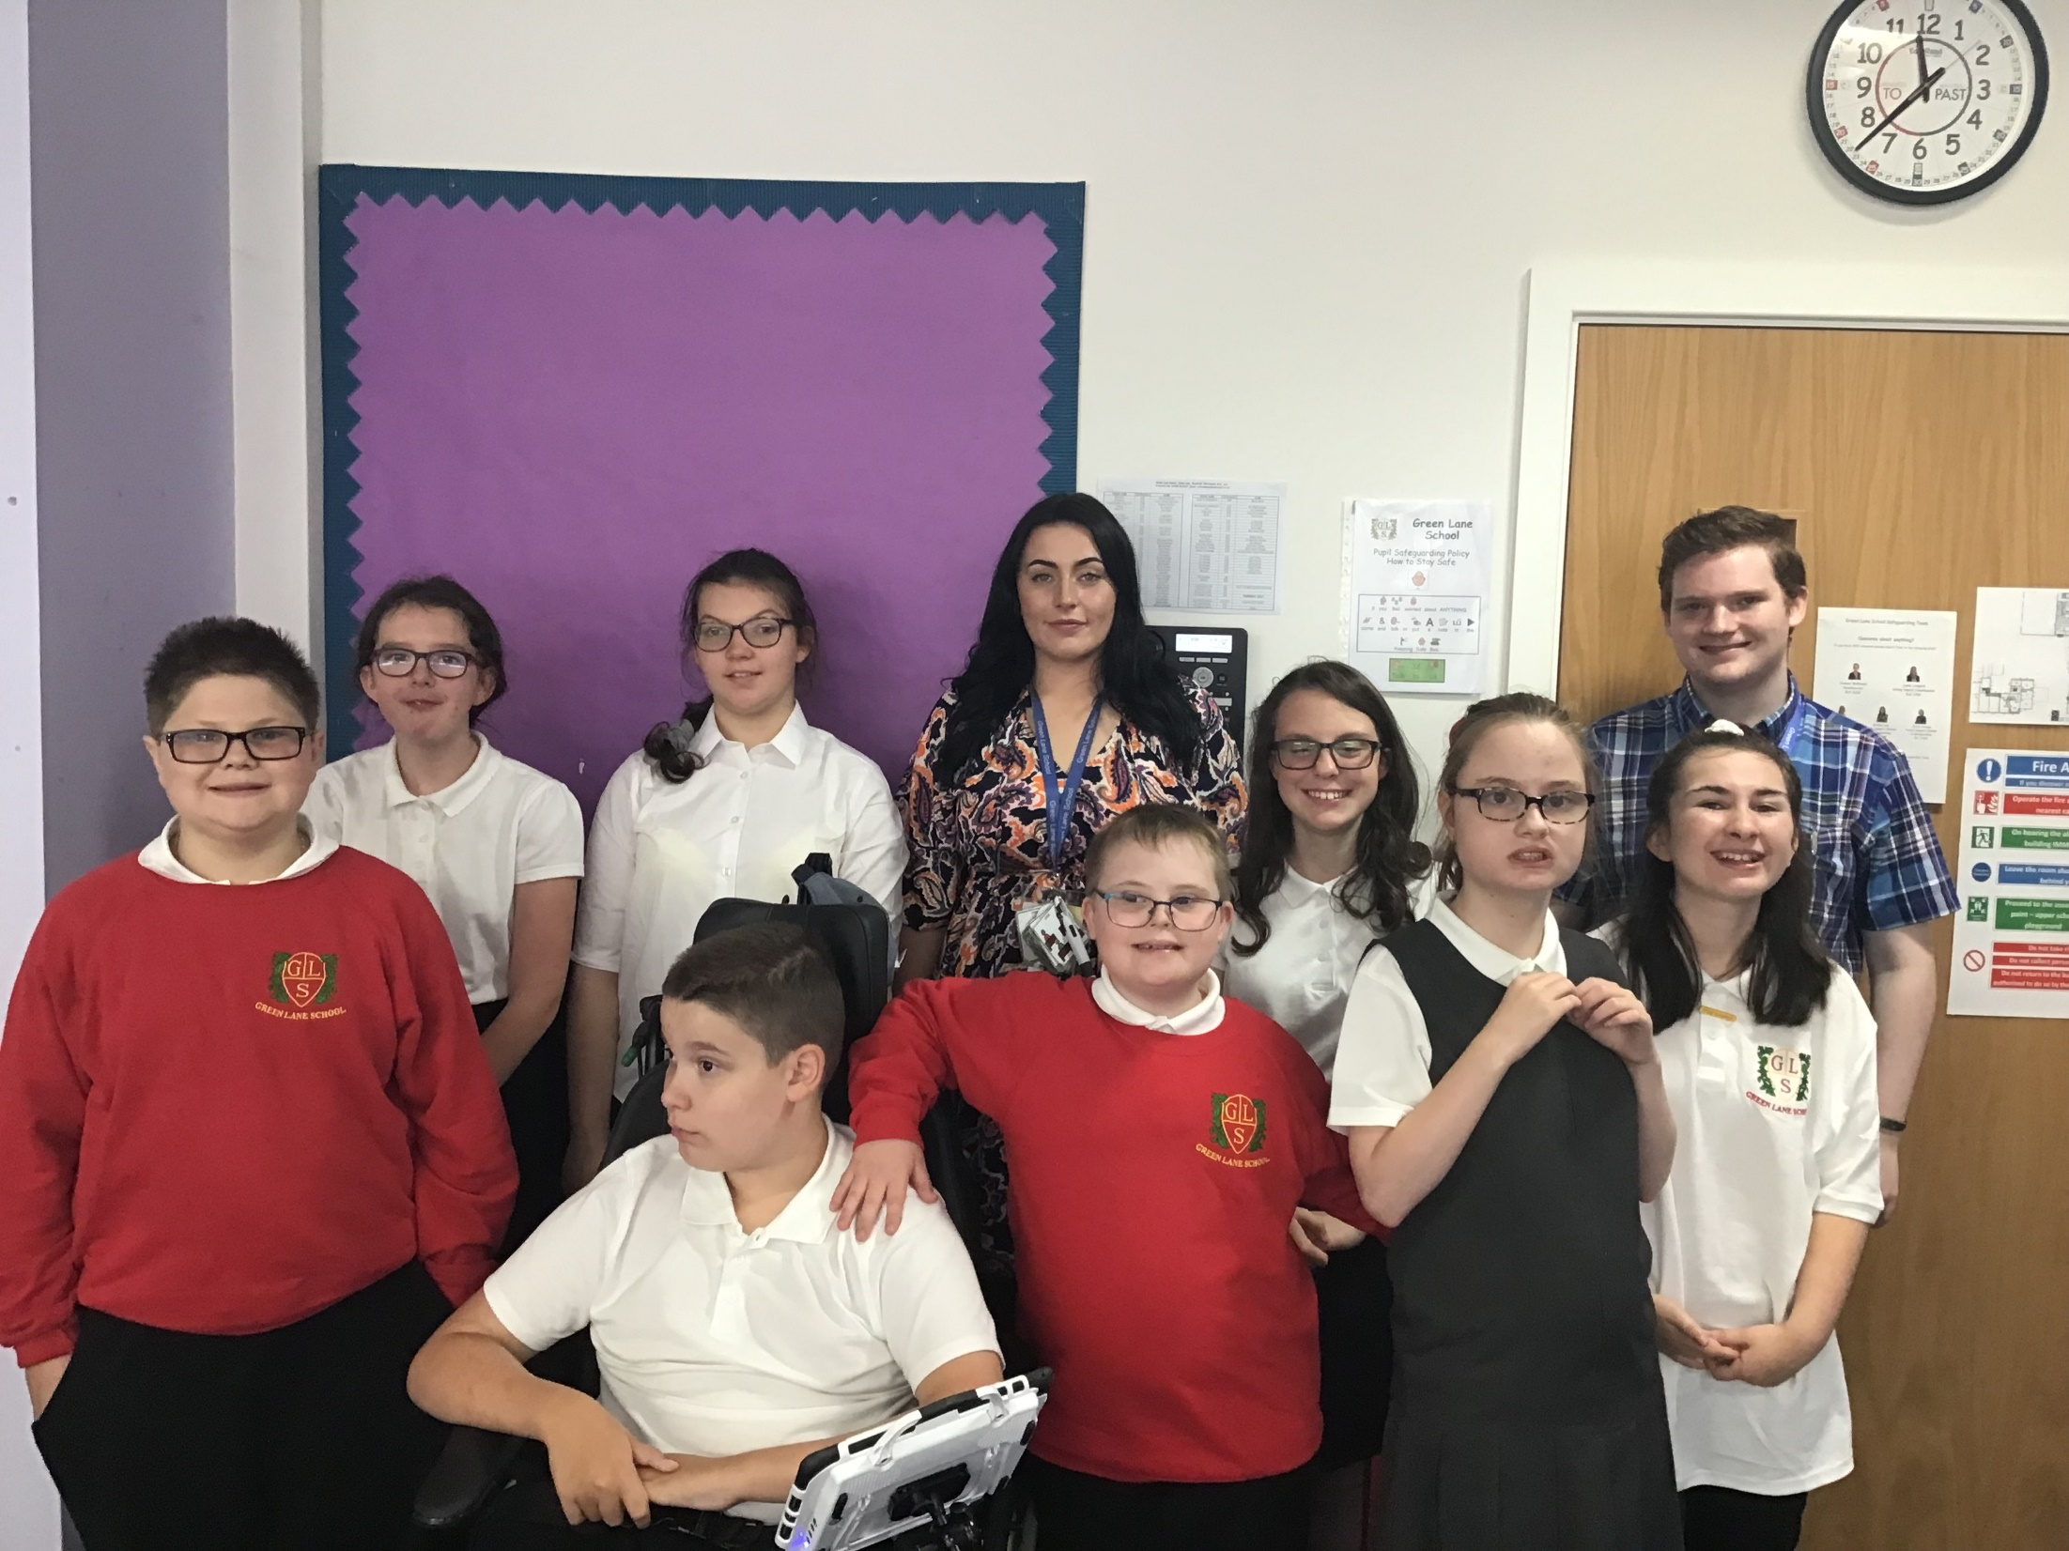
Deer Class is a Key Stage 3 class made up of 9 pupils from Years 7, 8 and 9.

Slide 5


On arrival…
Juice, water and toast are available on arrival each morning.
We also do a Café session on a Monday morning where we bring in different foods each week for the children to try. We are also looking to travel in to the community to practise our social skills outside of school.
A contribution of £1 per week towards this cost is received with thanks as school do not fund this.

Slide 6

Equipment
All equipment is provided by school. Pupils each have their own pencil case which contains everything that they could possibly need in class.
They do not need to bring in any stationary equipment from home.
Pupils should come to school in their PE kit every Thursday.

Slide 7



What should pupils bring to school daily?
Every pupil in Deer Class is given a home-school book. This is a way of communicating any important messages and information. If there are no messages in the book this means that there is nothing additional to mention for that day. Please check this book each day. Please use this book to communicate anything we need to know.
Reading books and records are given in line with pupils phonics assessments. Please aim to read with your child on a 1:1 basis 3x each week. Please record in the reading record when you have read with your child at home.
Books will be changed as required. Please write in the home school book if you feel your child’s book needs to be changed.
Water bottles. We encourage pupils to bring in water bottles each day. We will refill them for them as needed and we will send them home each night to be cleaned..

Slide 8
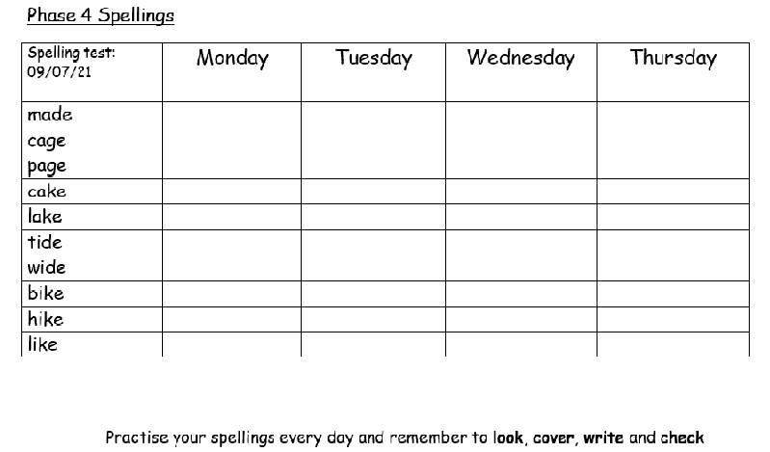
Spellings and homework
Weekly spellings will be sent home on a Tuesday. There is a weekly spelling test each Monday.
Pupils will have the opportunity to practise these in class each morning but should also practise at home using look, cover, write and check.
English and Maths (alternate) homework is sent home every Friday. Pupils should return this on a Monday morning.

Slide 9
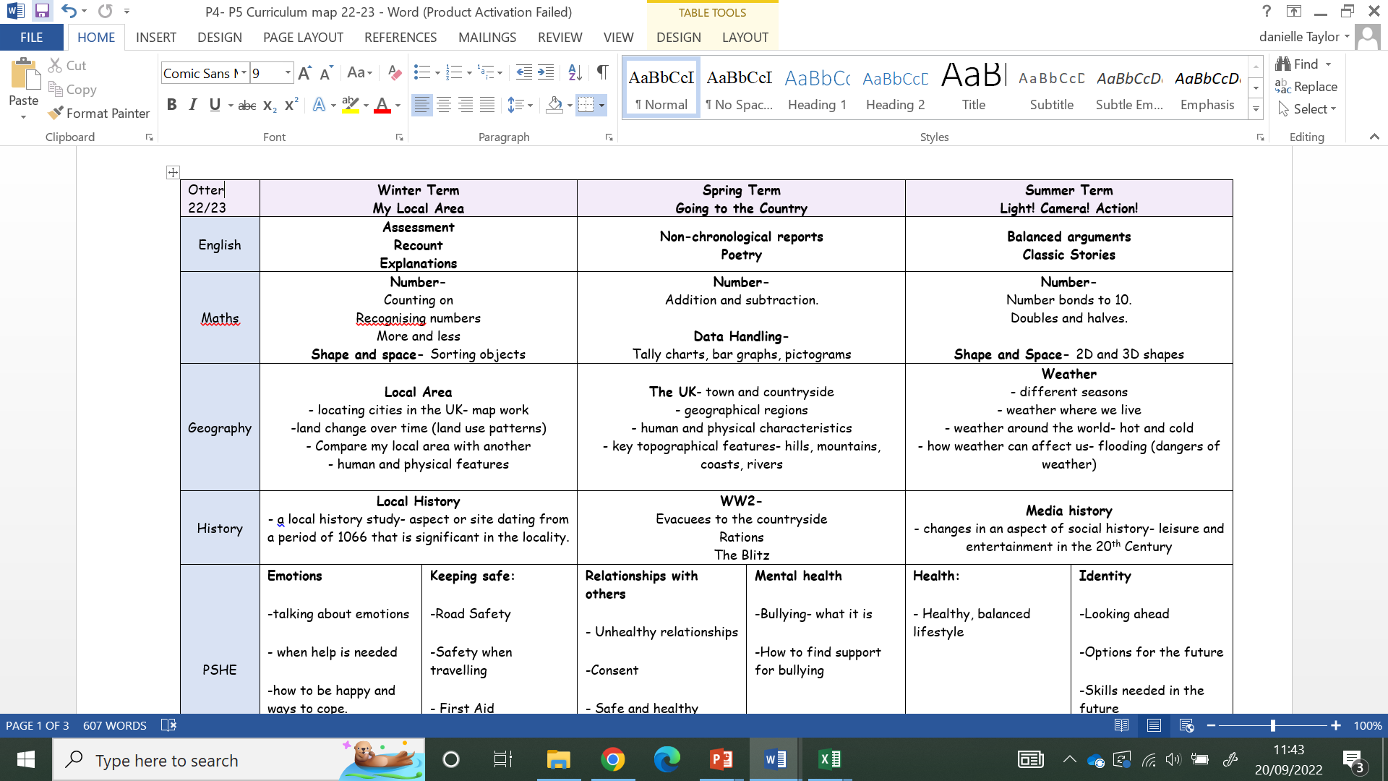
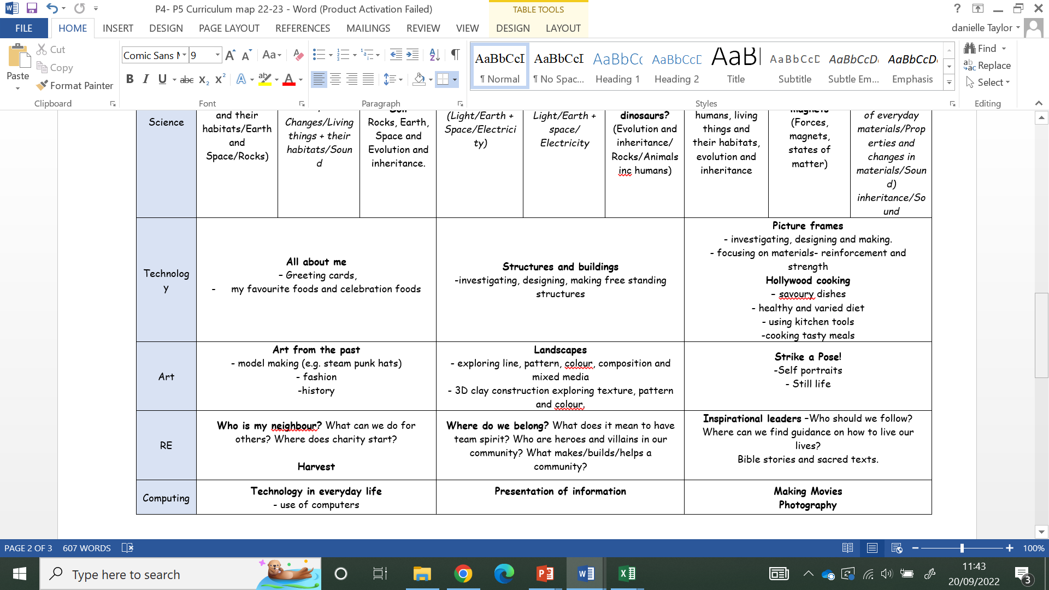
Deer Curriculum
The curriculum we do in Deer class is topic based, this means that we try and link our learning across the curriculum to give the children more exposure to the topics.

Slide 10
Termly overviews
At the beginning of each term you will be sent an overview showing what topics are being taught in each subject for that term..

Slide 11

Any questions?

Slide 12

Thank you for taking the time to join us!
As always your support is much appreciated.

